Slide 1


Databases 2
Diagram entity-relation
Ngadhnjim Kolgeci George Ugulava
Alisa Hoti Dorentina Bejtullahu
Zhenya

Slide 2


An Entity-Relationship Diagram (ERD) is a graphical representation used in database design to model the structure of a database system. It is a visual tool for depicting the entities, attributes, and the relationships between these entities in a database. ERDs are commonly used by database designers and developers to plan and communicate the design of a database system.

Slide 3
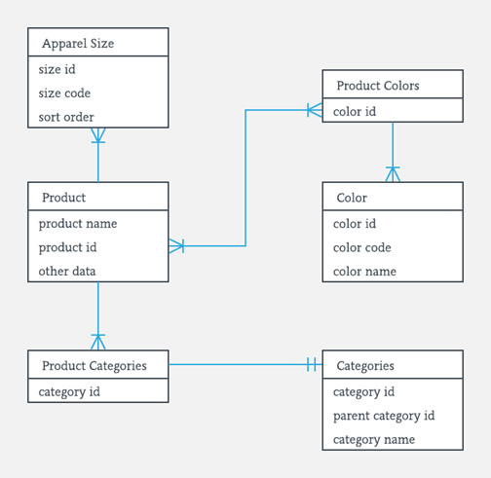
Key components of an Entity-Relationship Diagram
Entities: Entities represent real-world objects, concepts, or things that can be stored in a database. Each entity is typically shown as a rectangle in the diagram. Examples of entities might include "Customer," "Product," "Employee," etc.
Attributes: Attributes are the properties or characteristics of entities. These are shown as ovals connected to the respective entity. For example, a "Customer" entity might have attributes such as "CustomerID," "Name," "Email," etc.
Relationships: Relationships illustrate how different entities are connected or related to each other. They are typically shown as lines connecting entities. For example, a "Customer" entity might have a relationship with an "Order" entity to represent that customers place orders.

Slide 4
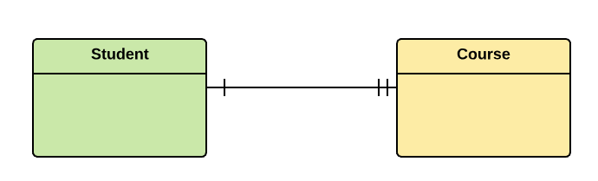
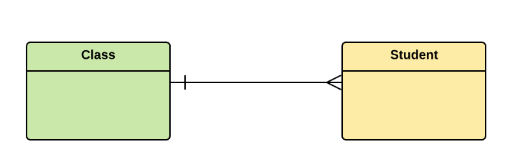
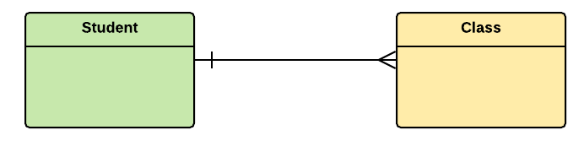
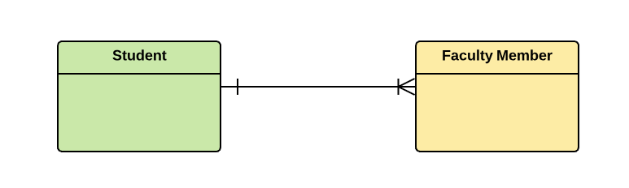
Key components of an Entity-Relationship Diagram
Cardinality: Cardinality represents the number of instances of one entity that can be related to the number of instances of another entity. It's often denoted with lines to specify whether the relationship is one-to-one, one-to-many, many-to-many, zero-to-many, or etc.
Primary Key: A primary key is an attribute (or a combination of attributes) that uniquely identifies each instance of an entity. It is often underlined in the diagram.
Foreign Key: A foreign key is an attribute in one entity that is used to establish a relationship with another entity. It is typically shown as an attribute in one entity that is derived from the primary key of another entity.

Slide 5

How to create an Entity-Relationship Diagram

